Slide 1







TechJobHub
Your gateway to tech careers

Slide 2


OVERVIEW
TechJobHub is an online platform changing how people find jobs and hire employees. It's like a personal career advisor for job seekers, helping them match their skills with the right job. Recruiters also can post jobs, set tests, and do interviews online. It's not just about finding jobs; it's a friendly place where job seekers and recruiters benefit together. Whether experienced or new, TechJobHub is the key to success in the digital realm..

Slide 3


Project Scope
Job Posting and Search
Resume Uploading and Parsing
Insightful Skill Matching
Customizable Assessments
Communication Channel
Feedback Mechanism

Slide 4


Motivation
Enhance the job-seeking experience
Support career growth and development
Cultivate user interaction
Offer ease and adaptability
Guarantee user contentment:

Slide 5

Stakeholders
Job Seekers
Tech Companies and Startups
Developers

Slide 6



FEATURES
Resume Parsing
Skill-Based Job Recommendations
Recruitment Resources
Job Alerts & Notifications
Skills Assessment
Tailored Interviews
Confidential Ratings
Confirmation System

Slide 7

Model

Slide 8
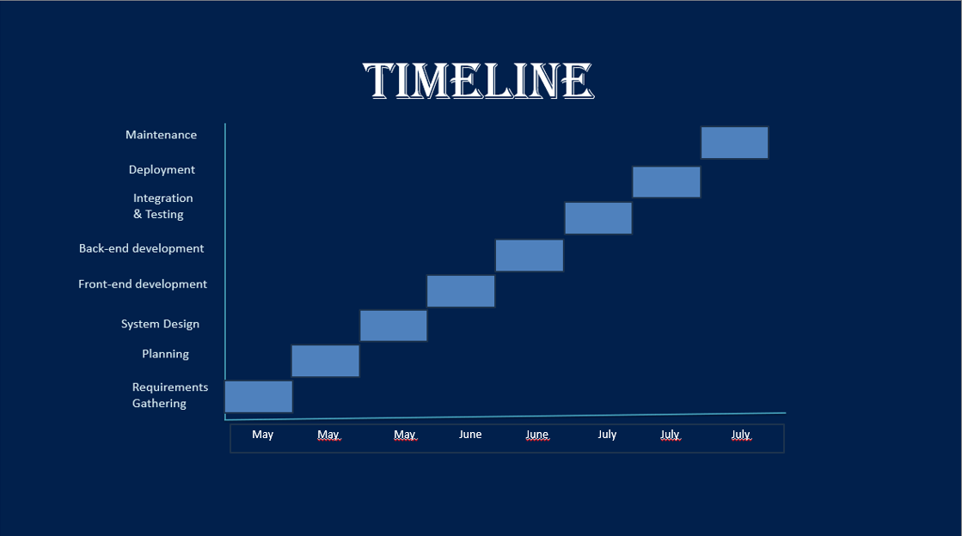
20 June 2025

Slide 9


LANGUAGES & TOOLS
Frontend Development:
HTML
CSS
JavaScript
Backend Development:
Python
Django
NLP (Natural Language Processing)
Database Management:
SQL (Structured Query Language
VS Code

Slide 10
CHALLENGES
Accuracy of Resume Parsing
Matching Mechanism
Assessment Sessions
Privacy and Security
Scalability
20 June 2025

Slide 11

ANY QUERY

Slide 12
Thank You

